Slide 1
Welcome to the ESOL Program at Hope School!
Information for parents
ESOL = English for
Speakers of
Other
Languages
Designed by Jan Dormer, Messiah College

Slide 2
Welcome parents!
We are happy that you are here!
I am Sarah.
I am Jan.
I am Lilian.
We are the ESOL teachers at Hope School.

Slide 3
Today we will talk about:
Learning English in School
Our ESOL Program
Hope School
How you can help
Your questions

Slide 4
Learning English in School
What does your child need to learn?
Social English
Academic English (the English of math, science, history, etc.)
A new culture
This is a lot of learning!
It will take several years.

Slide 5
Learning Academic Subjects
While your child is learning English, he or she will learn math, science, history, and other subjects.
This can be difficult.
We will help your child!

Slide 6
How does a student get in the ESOL Program?
Parents fill out a “Home Language Survey”. This helps us know your home languages.
Students take an English test. This tells us if the ESOL program can help the student.

Slide 7
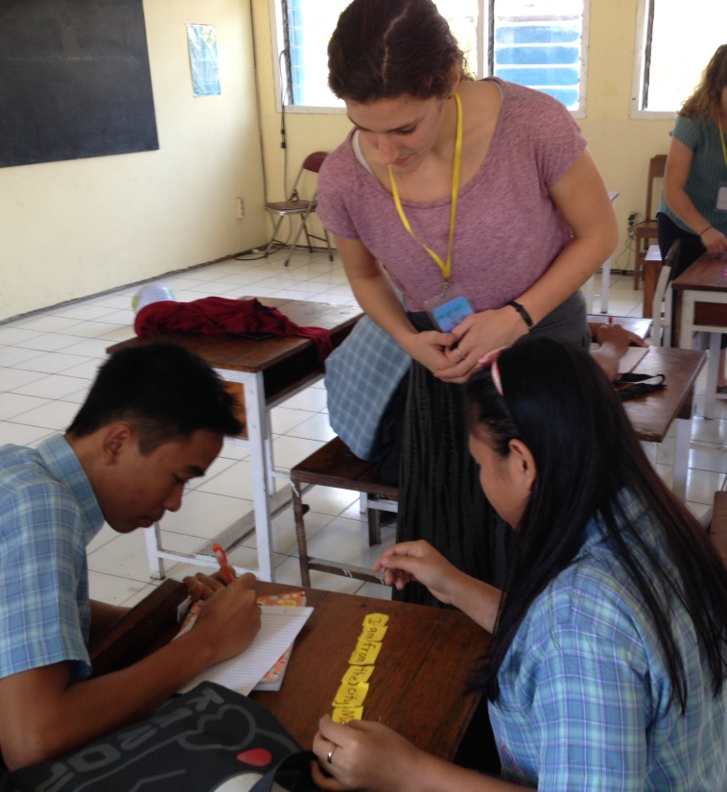
Our ESOL Program
Three ways to learn
English and academics:
The ESOL classroom:
focus on English.
The regular classroom: focus on academics; learn some English.
The sheltered classroom: focus on English and academics together.

Slide 8
Hope School Information for ESOL Students and Families
We want to help you!
Tell us how we can talk to you (email, phone, language). Let us know how your child feels, and what he/she needs.
We will send you letters about your child’s learning.
Your child can bring a lunch and eat lunch in the ESOL classroom.

Slide 9
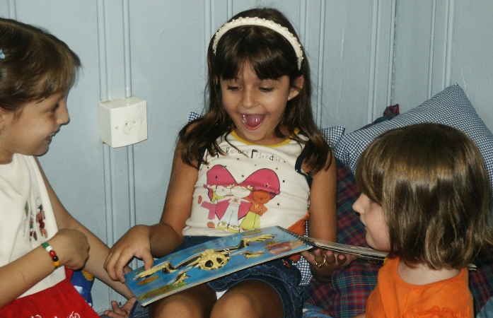
How you can help
You can help your child!
Speak your native language at home, and read to your child in your native language.
Let your child do his/her own homework. If your child cannot do his/her homework, tell us.
Come to parent-teacher meetings.
Be patient. Language learning takes a long time!

Slide 10
ASK QUESTIONS!
We are happy to answer them!

