Slide 1
Design for an Effective ESOL Class

Slide 2
Summary
A good ESOL class primarily helps students develop the language skills of reading and listening (language input) and writing and speaking (language output), as they use these skills for real communication. In addition, a good ESOL class focuses on achieving fluency in all four of these skills. Some limited focus on the language itself through grammar and vocabulary study (as opposed to using the language for communication) can also be helpful, but this type of language study should not comprise more than 25% of class time. For the bulk of class time, 75%, students should be engaged in real communication through reading, writing, speaking, and listening.

Slide 3
The Four Components

Slide 4
INPUT Students read and listen.
Content should be…
1. Comprehensible: just a little above students’ current level.
2. Meaningful: interesting and motivating
3. Authentic:
real communication
4. Only 5% new words
and structures

Slide 5
OUTPUT Students speak and write.
Strive for…
1. Appropriate expectations:
length, accuracy, discourse
2. Low stress: pairs and
groups; group to individual
response
3. Authentic output: fostering
real communication
4. Only 5% new words and structures

Slide 6
FLUENCY Students develop ease in speaking, listening, reading and writing, with known words.
Provide repetition that is…
1. Meaningful
2. Has NO
new words.
2. Is authentic:
useful in real
communication
3. Fun… use songs,
games and chants

Slide 7
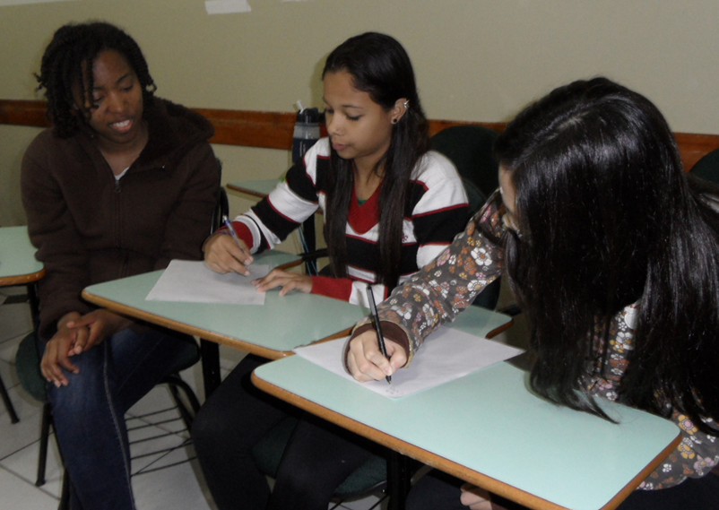
LANGUAGE FOCUS Students study grammar, vocabulary and pronunciation.
Strive to…
1. Build understanding, not memorization.
2. Provide mini-lessons (5 min. or less) on words, structures and pronunciation, as needed.
3. Make connections to
real communication.
4. Derive language focus from
a communicative curriculum,
rather than being
the source of the curriculum.

Slide 8
References for the Four Components:
Nation, I.S.P. and Newton, Jonathan (2008) Teaching ESL/EFL Listening and Speaking (ESL & Applied Linguistics Professional Series). NY: Routledge. ISBN-13: 978-0415989701
Nation, I.S.P. (2008) Teaching ESL/EFL Reading and Writing (ESL & Applied Linguistics Professional Series). NY: Routledge. ISBN-13: 978-0415989688

