Slide 1
Can or can’t?
Write a sentence with your answer.
1 point for a correct answer
1 point for a good sentence

Slide 2
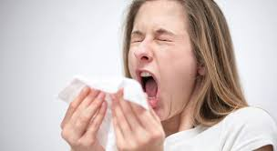
Can a person sneeze with their eyes open?
Yes they can. or No they can’t.

Slide 3
Can a person sneeze with their eyes open?
Yes they can. or No they can’t.

Slide 4
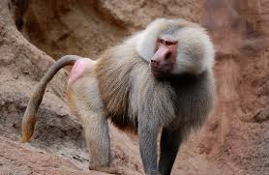
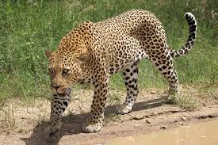
Can a baboon kill a leopard?

Slide 5
Can a baboon kill a leopard?
Yes, it can.

Slide 6
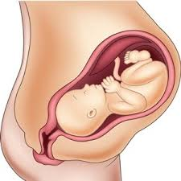
Can a baby in the womb hear sounds?

Slide 7
Can a baby in the womb hear sounds?
Yes it can.

Slide 8
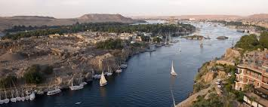
Can the Nile river freeze?

Slide 9
Can the Nile river freeze?
Yes it can.

Slide 10
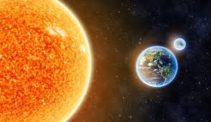
Can the sun go around the earth?

Slide 11
Can the sun go around the earth?
No it can’t.

Slide 12
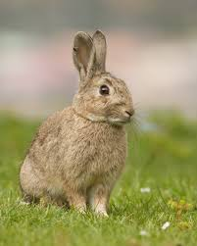
Can a rabbit walk?

Slide 13
Can a rabbit walk?
No it can’t.

Slide 14
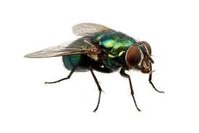
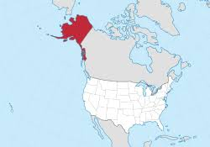

Can flies live in Alaska?

Slide 15
Can flies live in Alaska?
Yes they can.

Slide 16
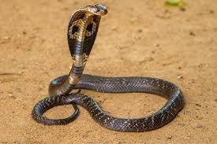
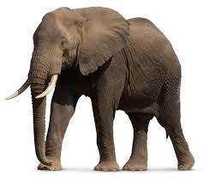
Can a cobra’s bite kill an elephant?

Slide 17
Can a cobra’s bite kill an elephant?
Yes it can.

Slide 18
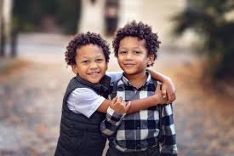

Can identical twins have matching fingerprints?

Slide 19
Can identical twins have matching fingerprints?
No, they can’t.

Slide 20
BONUS!!!!!

Slide 21
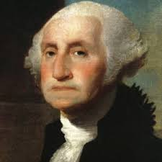
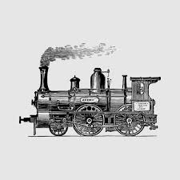
Could George Washington ride on a train?

Slide 22
Could George Washington ride on a train?
No he couldn’t.

Slide 23
Could George Washington ride on a train?
No he couldn’t.

