Slide 1
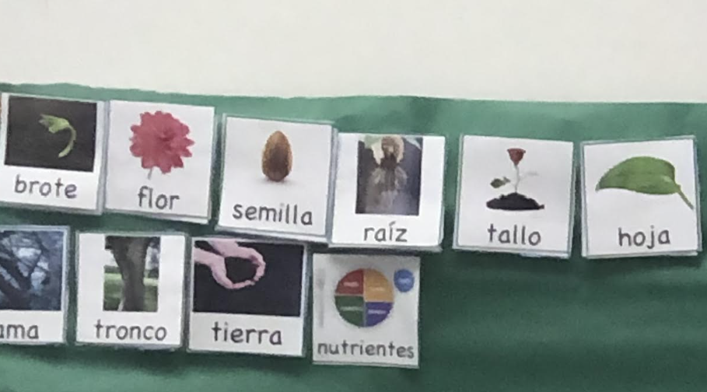
Word wall in the writing interest area and the words are also used for blending and segmenting

Slide 2
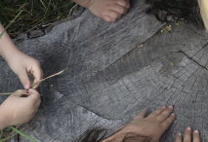
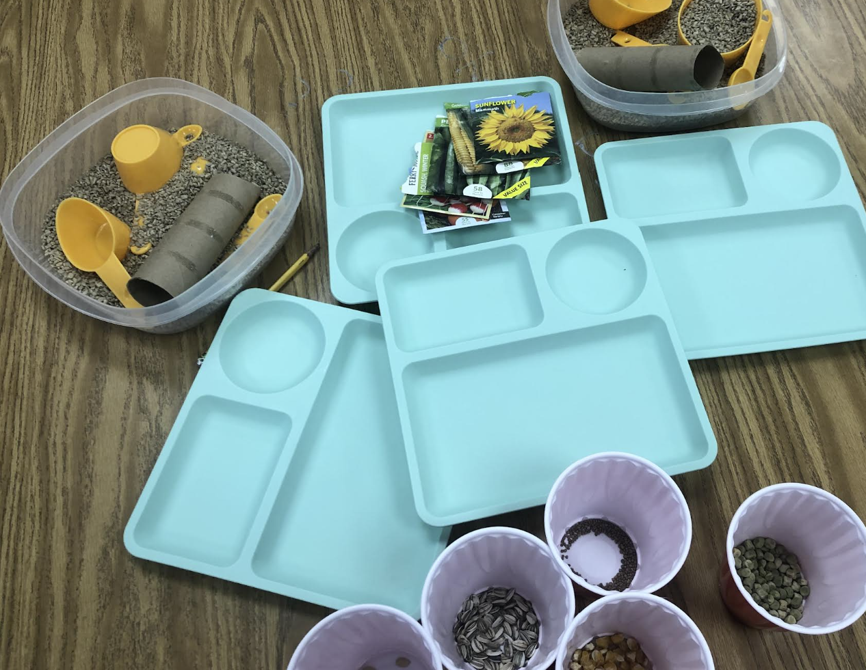
Tree Stump Provocation
Loose parts sorting and pour activity using different kinds of plant seeds.

Slide 3
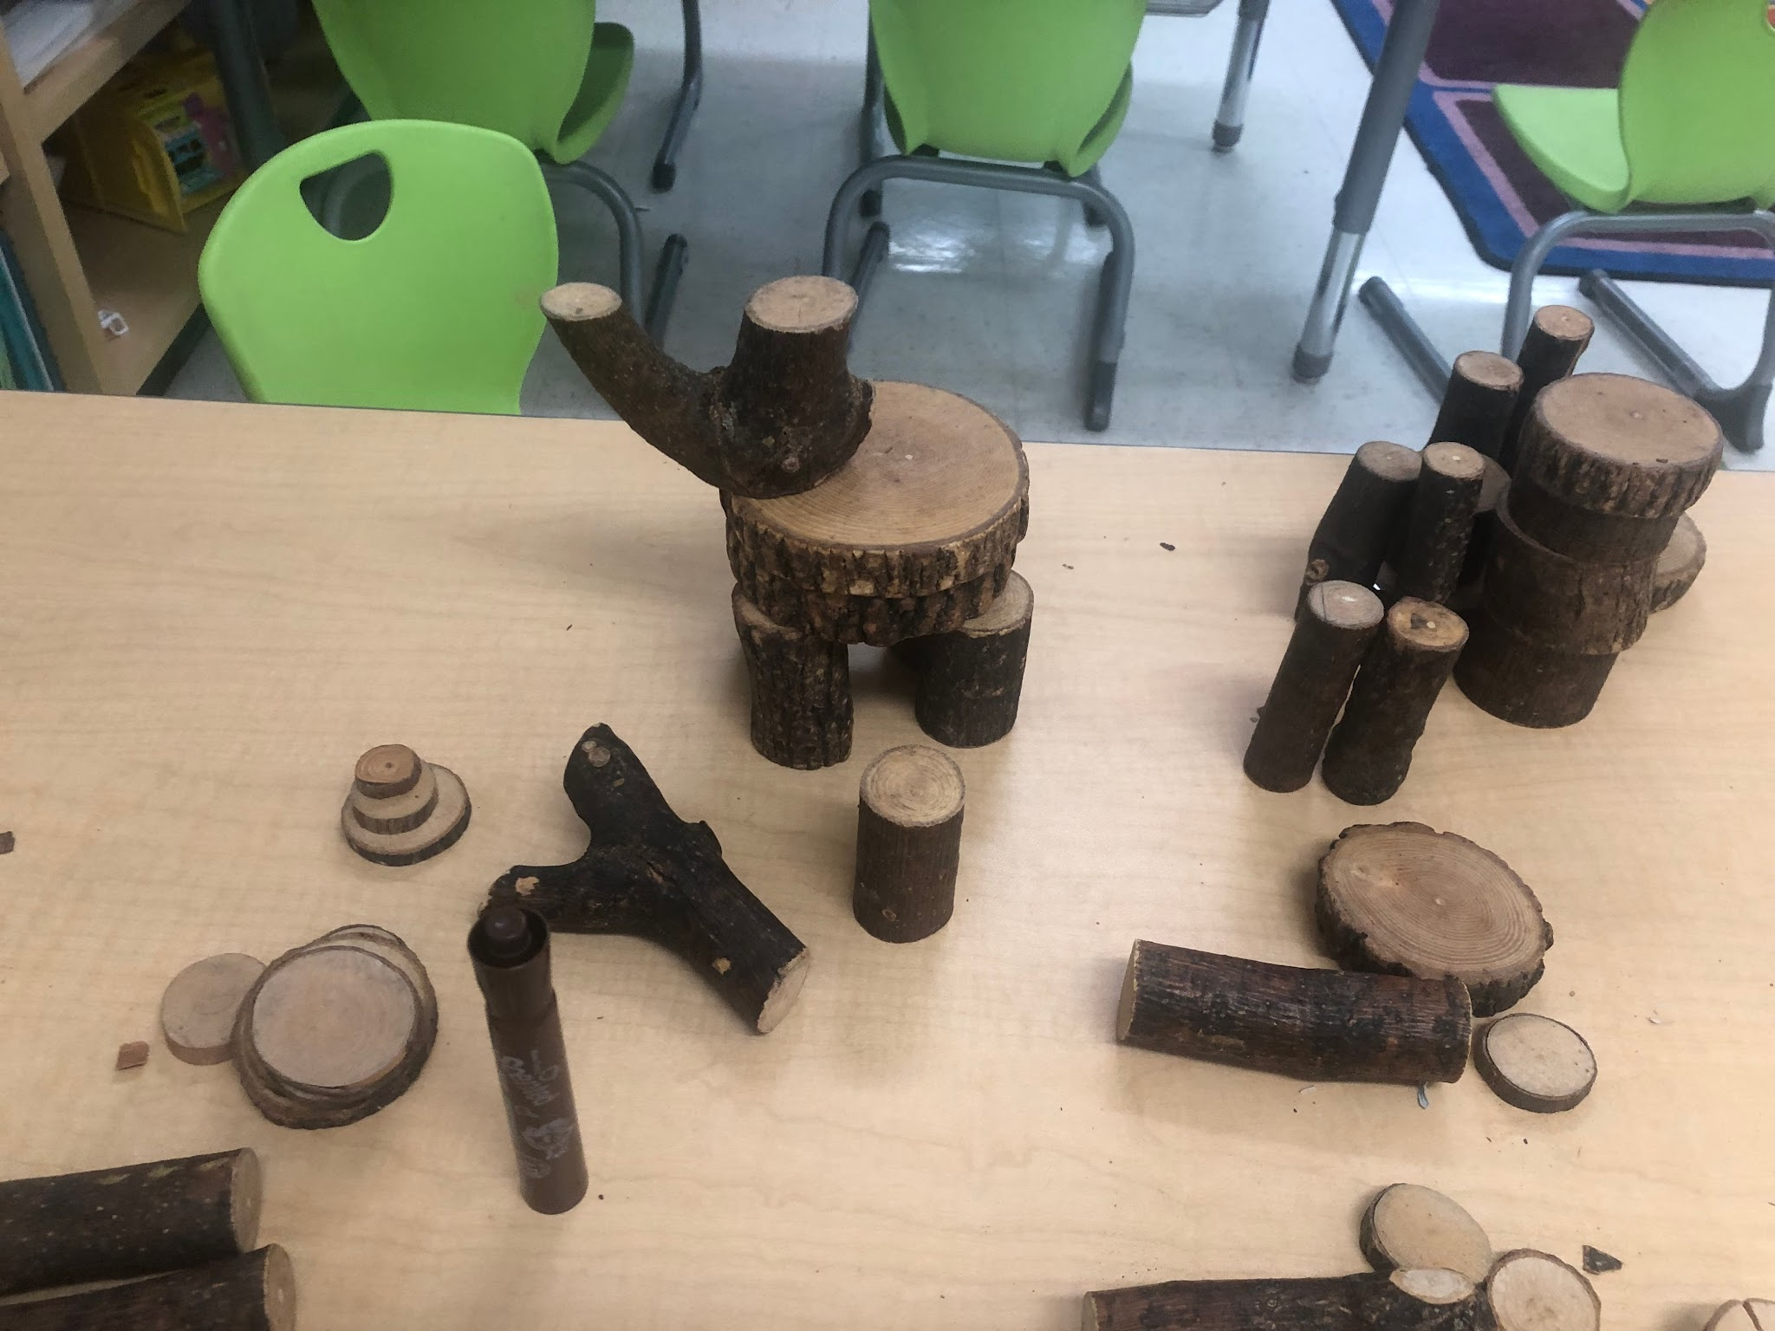
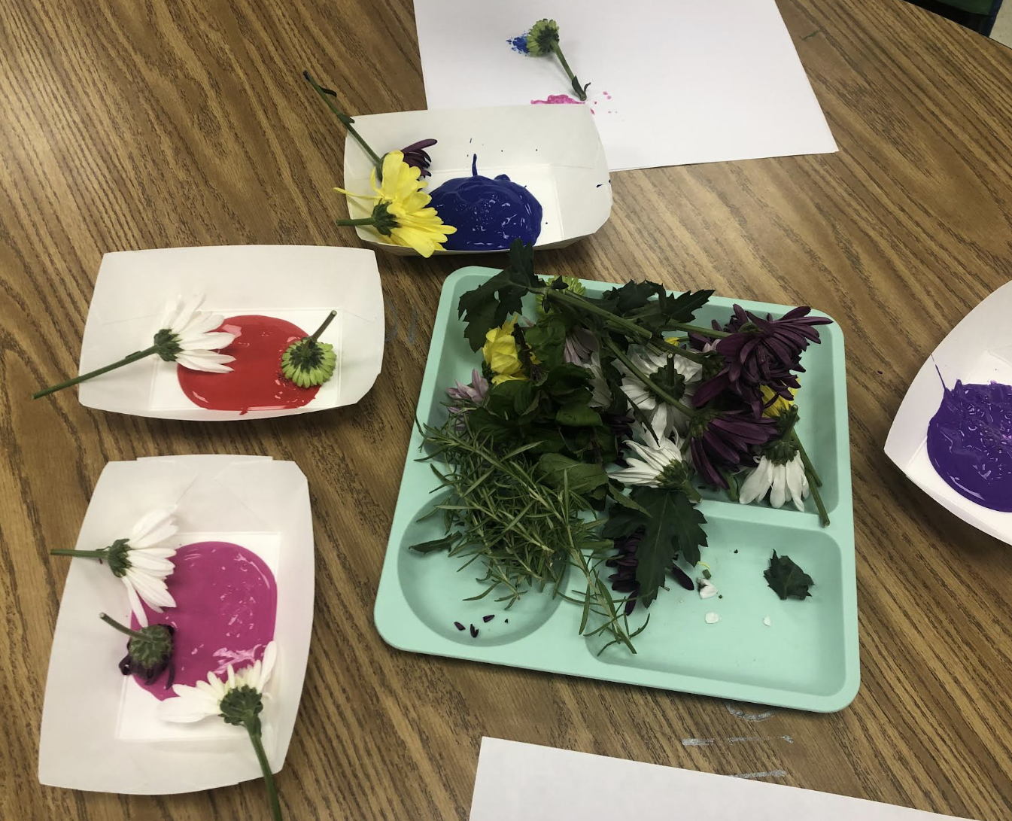
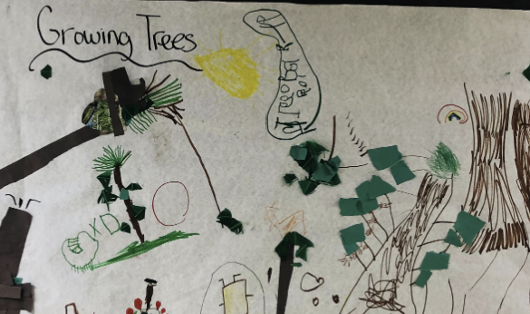
Examples of Content Add-ins
Tree parts added to block center
Herb and Flower Printing
Group Tree Cycle Collage

Slide 4
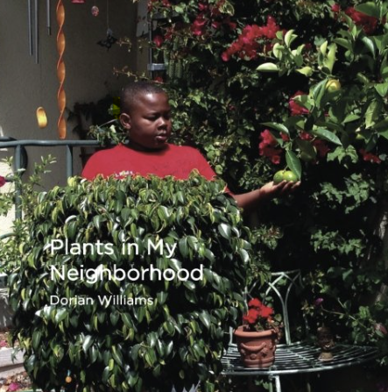
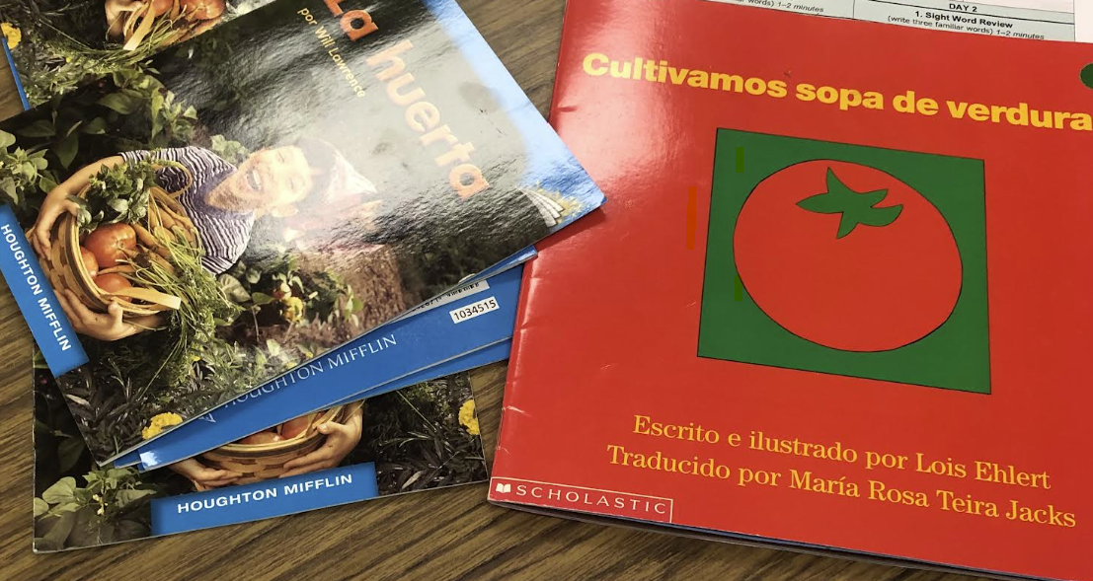
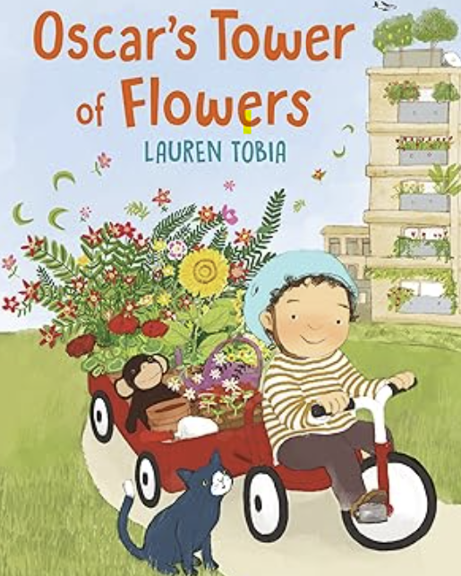
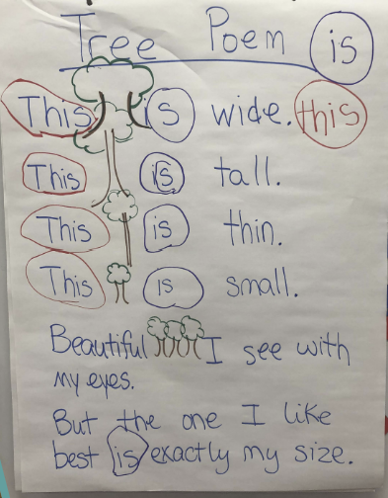
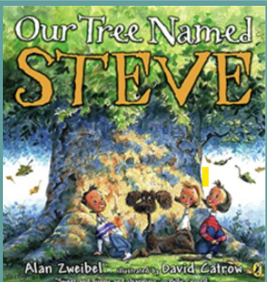
Realistic Fiction Anchor Text and Nonfiction Texts for small group reading strategy groups
Additional Books in text Set
Fiction Anchor Text
Content Poem to practice Foundational Skills.

Slide 5
Art and Discovery Content-embedded Process Art
Group Collage
Herb and Flower Printing

Slide 6
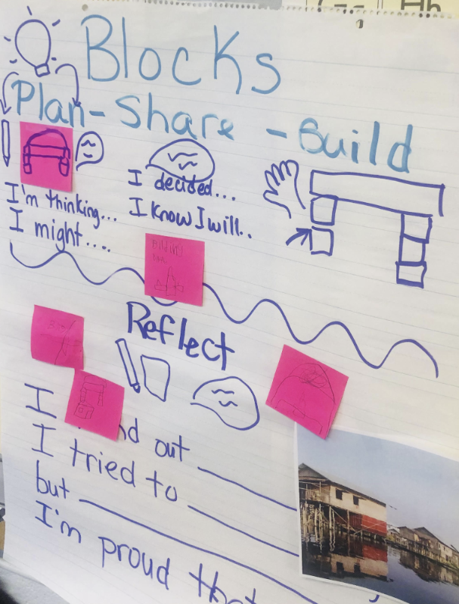
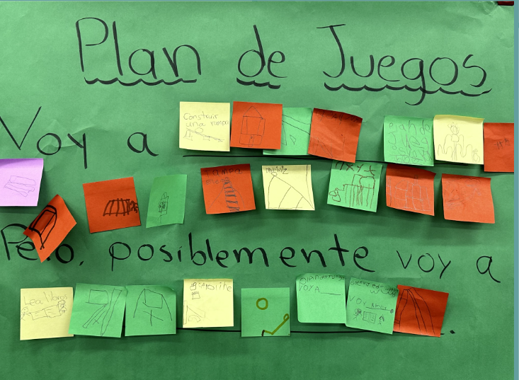
Examples of anchor charts that foster oracy in interest areas

