Slide 1
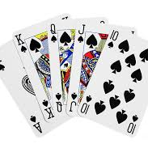
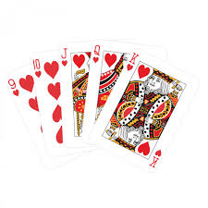
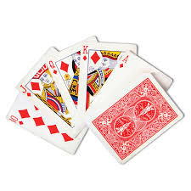
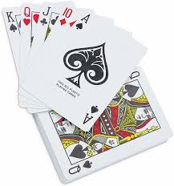
Word Kang
By Teacher Joe Mary G. Ibañez

Slide 2
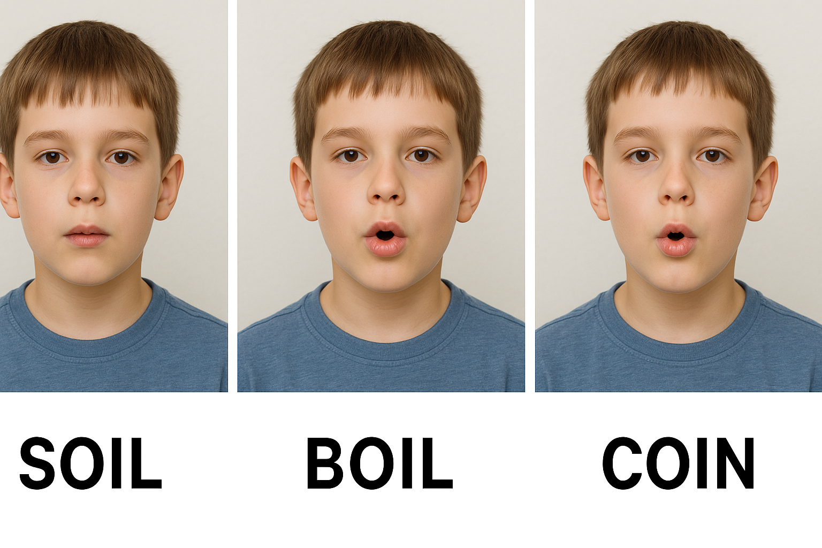
Steps
Form groups of 6 players.
Sit in a circle or as a group, using a table in the center.
Get the Word Kang cards and distribute 6 cards each.
Select one card from the 6 cards, whoever has the highest number will begin.
Take one card from the deck and put a card/cards on table.
Pronounce the word or pair of words aloud, with emphasis on clear pronunciation.
Take turns pronouncing, selecting cards from the deck, and drawing pairs of similar cards in a clockwise pattern.
The objective of the game is to correctly pronounce the word written on each card.
AI generated photo.

Slide 3
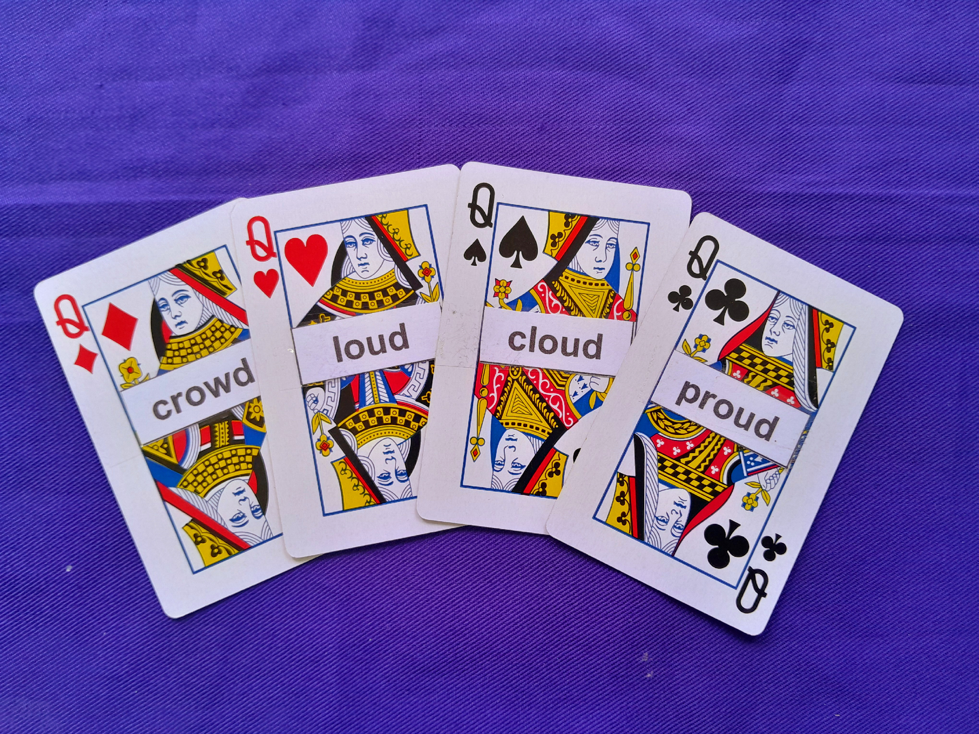
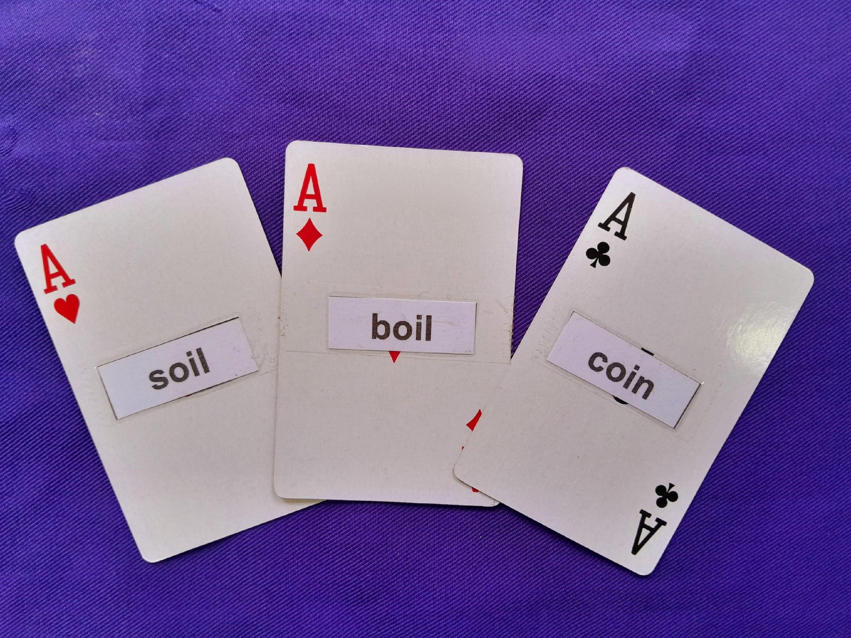
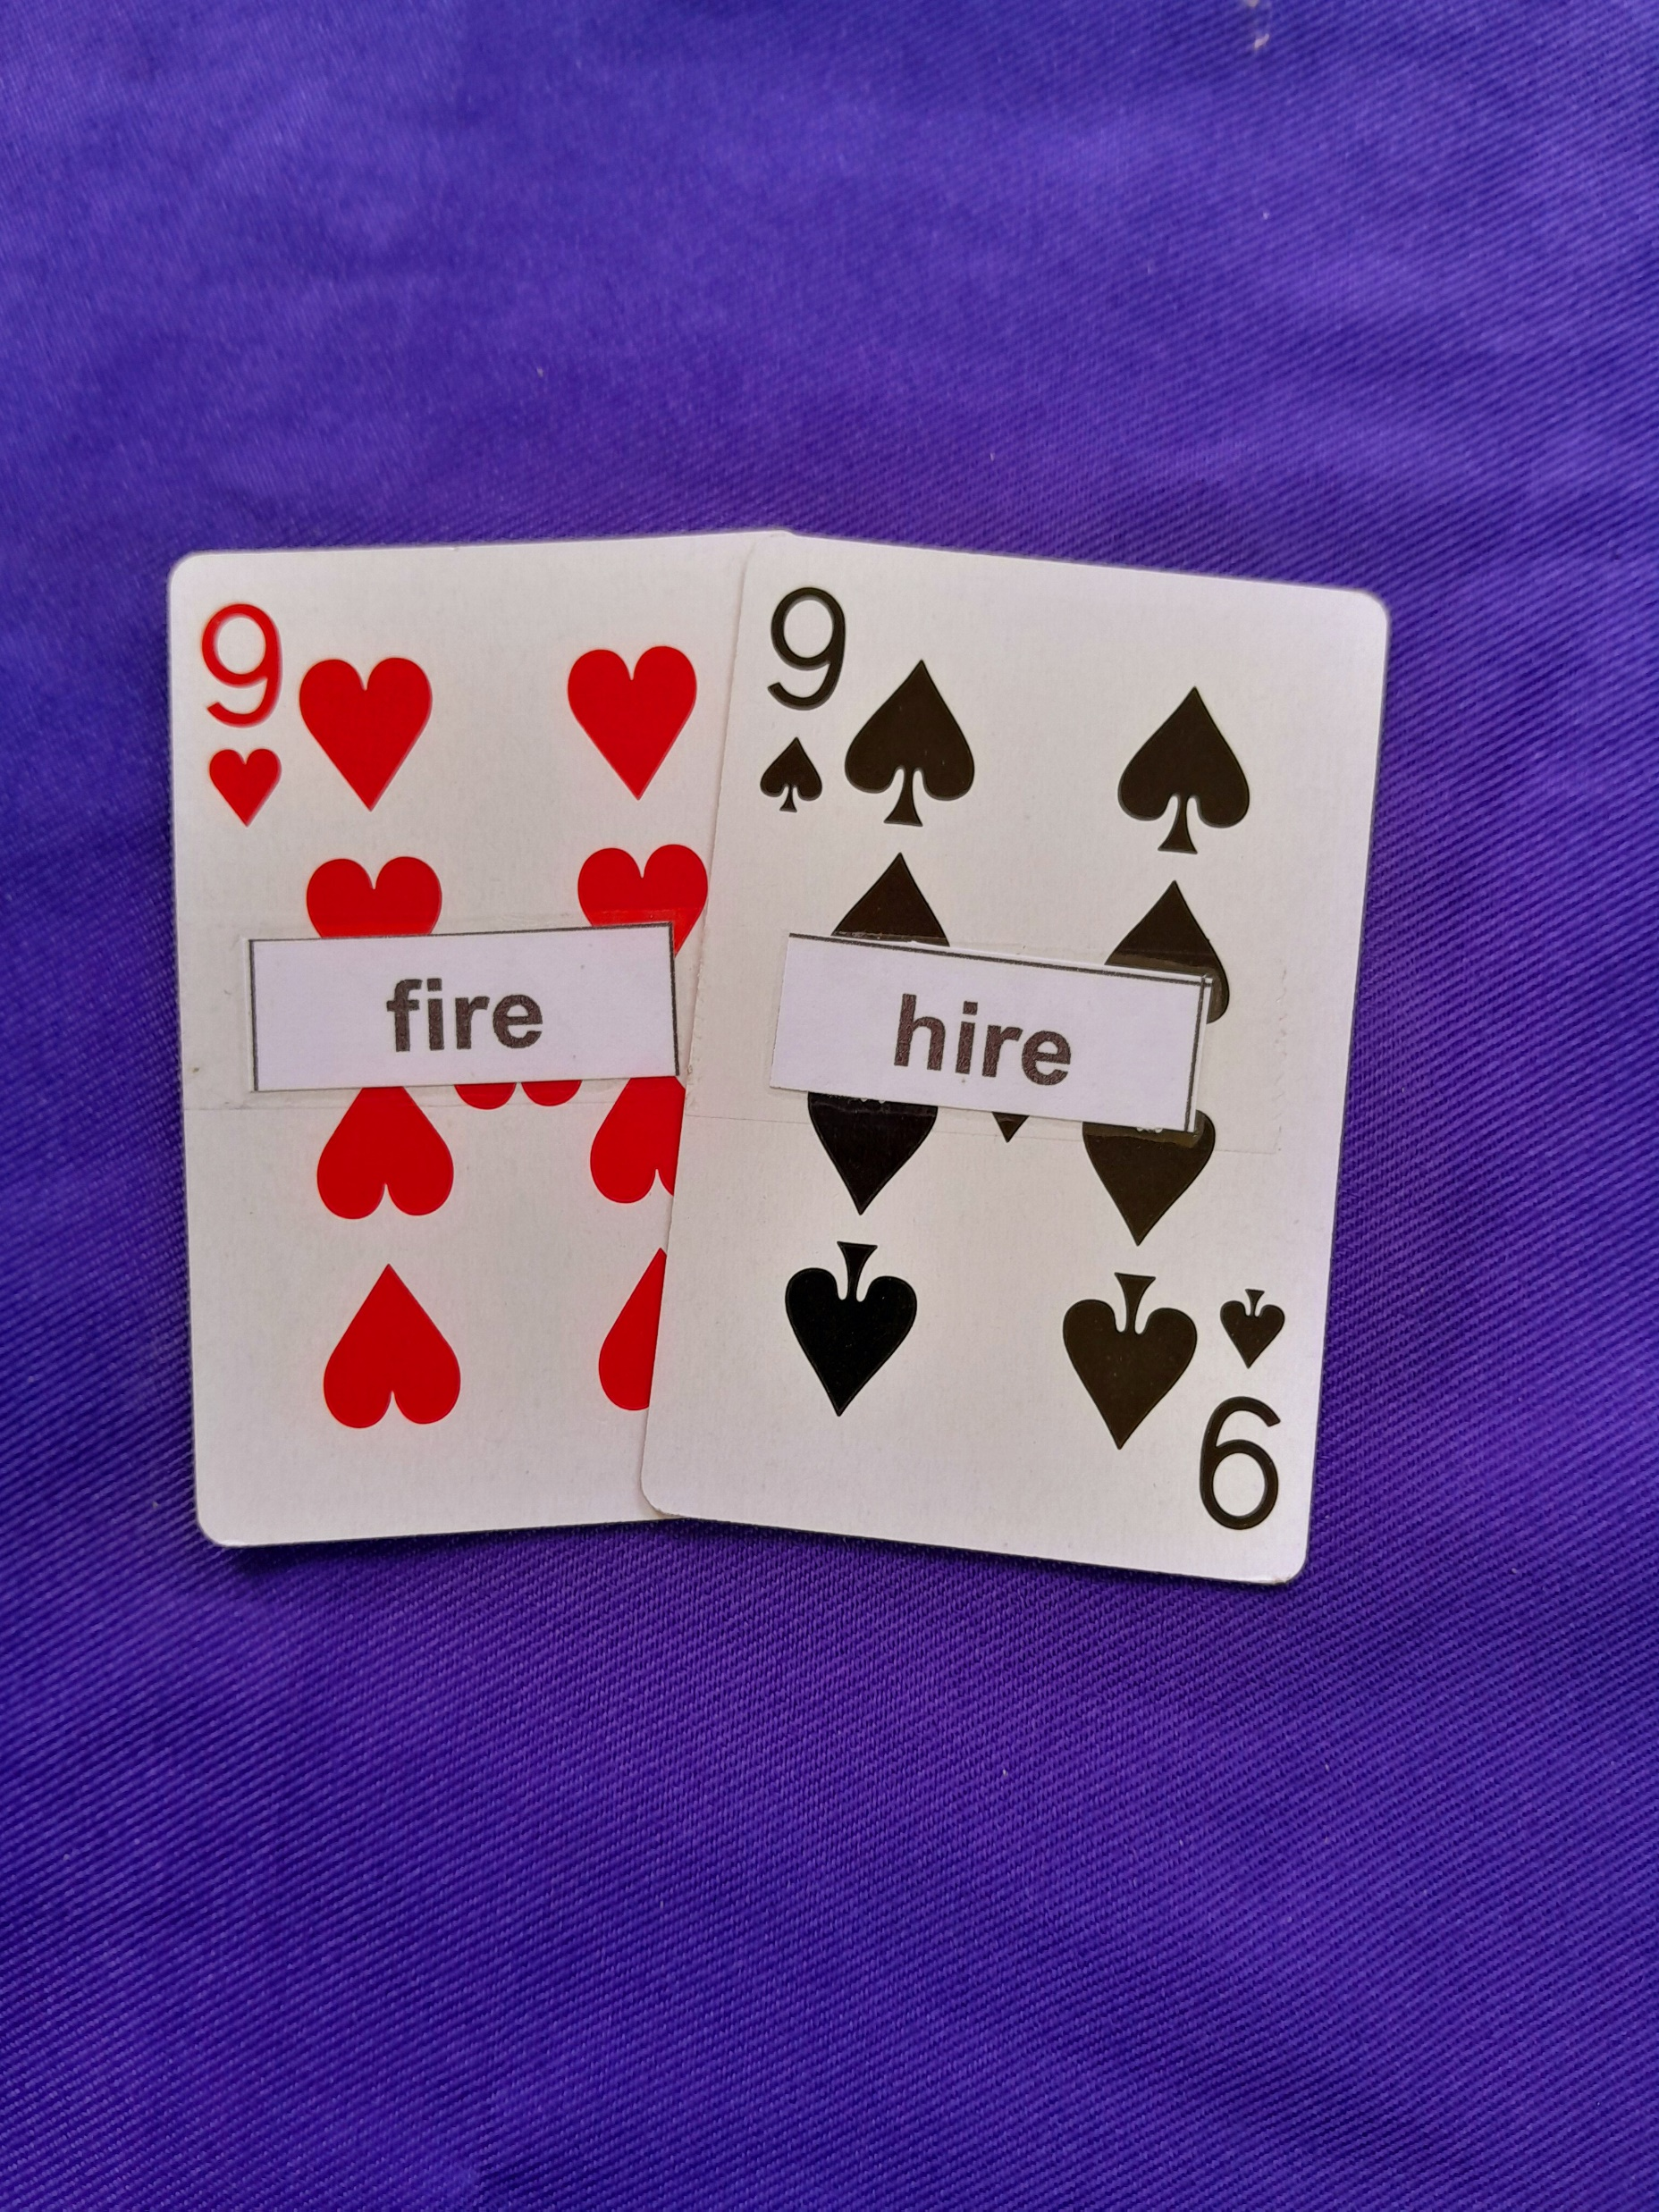
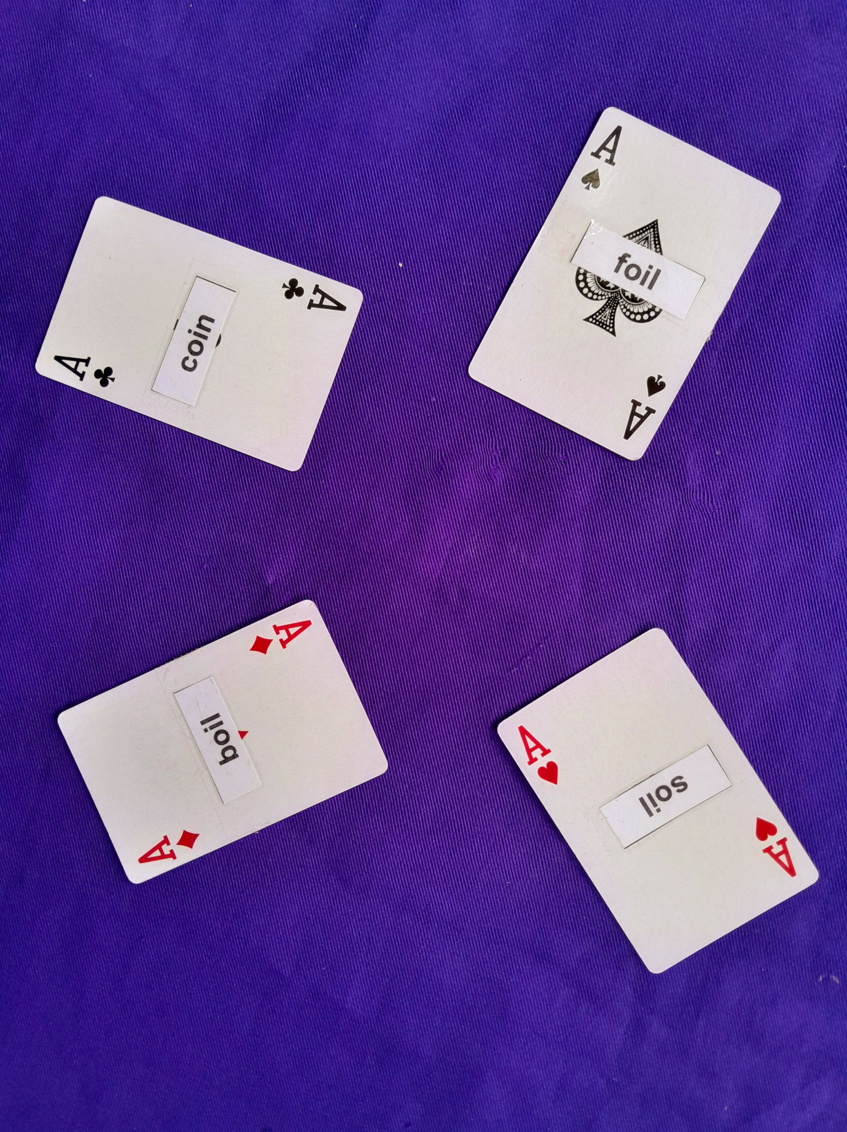
Card Combinations
4 cards
3 cards
2 cards or pair
single card

Slide 4
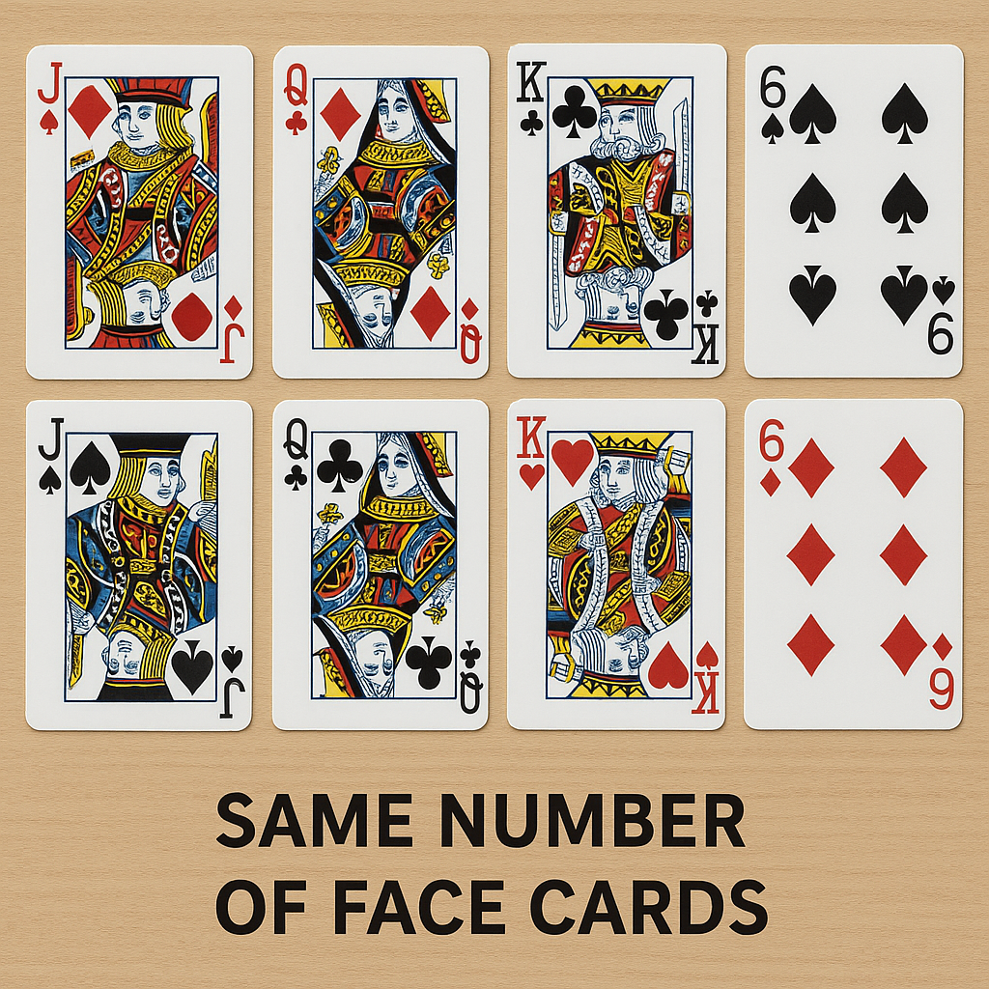
Steps
If a player draws a single, pair, or triple card with the same number of face cards, the following player may do the same. This should be done continuously, with each word pronounced. In this case, a player may also draw four cards or four-card sets.
The player can ask for "Kang". The player should draw all of the cards in his or her hand. The player with the lowest card value or none left wins the game.
When there are no more cards left in the deck to draw, the game ends. Each player then counts the total value of the cards in their hand; the player with the lowest total wins the game.

