Slide 1
My musical AutoBiography
my life story in music

Slide 2
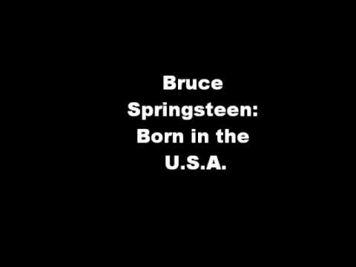
Born in the U.s.a., bruce Springsteen
In 1980, I was born in a small town in North Dakota, U.S.A.

Slide 3
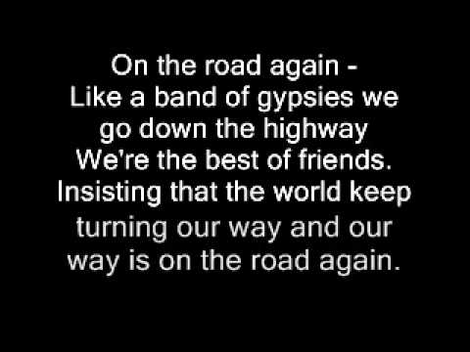
On the road again, WIllie Nelson
In 1988, my family moved to Denver, Colorado. I spent most of my life there.

Slide 4

Blitzkrieg pop, the ramones
In high school, I became interested in playing guitar and punk rock music.

Slide 5
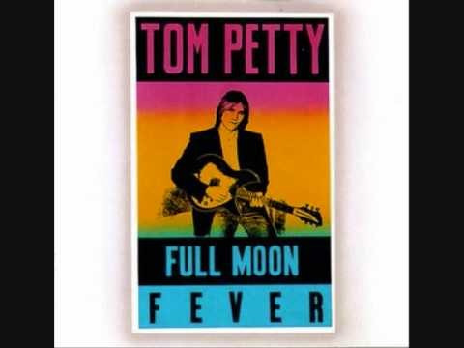
Running down a dream, tom petty
In 2007, I chose to follow my dream of traveling the world. I quit my job, left the United States and began teaching English in Costa Rica.

Slide 6

Arirang, Korean folk song
In 2009, I moved to South Korea to continue teaching English.

Slide 7
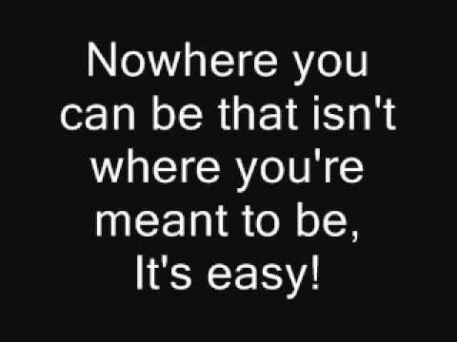
All you need is love, the beatles
In 2012, I married an amazing woman and the love of my life.

Slide 8
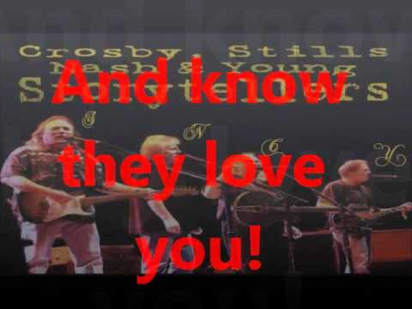
Teach your children, crosby, stills, nash and young
In 2014, my beautiful daughter was born.

