Slide 1


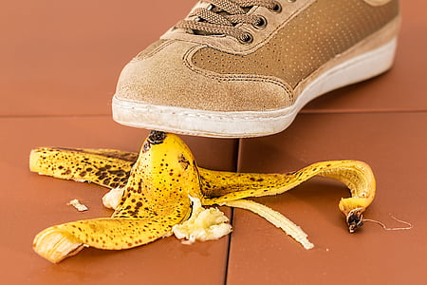
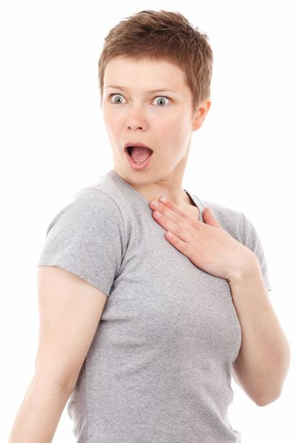
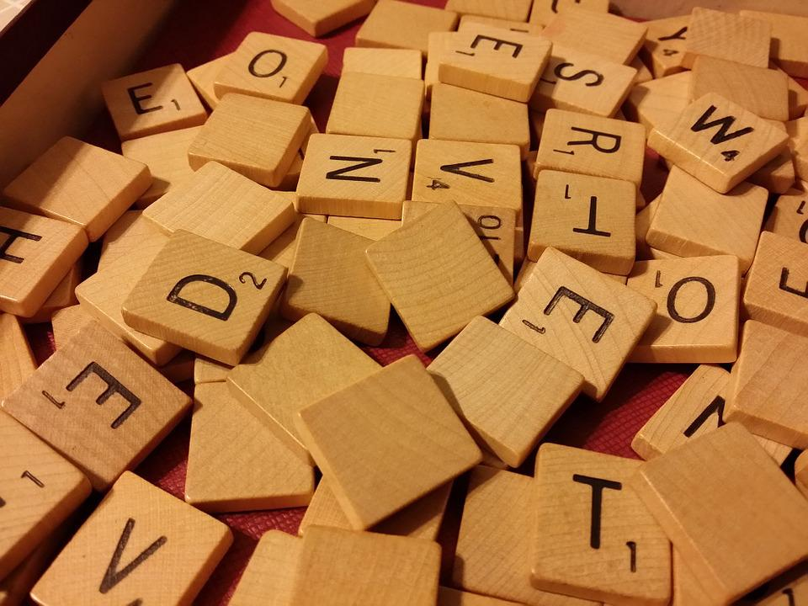
Survey Vocabulary
To conduct (a survey)- v., to organize and carry out
To target - v., to select as an object of attention
Demographic- n., a particular group of people
Outcome- n., the result
Anticipated- adj. probability of, expected result
Surprised- adj. unexpected, astonishing
How do you spell _______?

Slide 2

Survey Assignment Part 2:
Present the question in a bar graph.
https://nces.ed.gov/nceskids/graphing/classic/bar_pie_data.asp?ChartType=bar
Discuss & analyze your data by answering the following six questions:
What information does this bar graph show? (Include the title and x axis/ y axis).
What are the demographics of your survey? (Discuss your two variables).
What did the majority of respondents prefer? What did the minority prefer?
How would you be represented on the bar graph? Do the results surprise you? Why or why not?
What are three possible reasons for this outcome?
Based on the evidence, what conclusions can you draw?

Slide 3
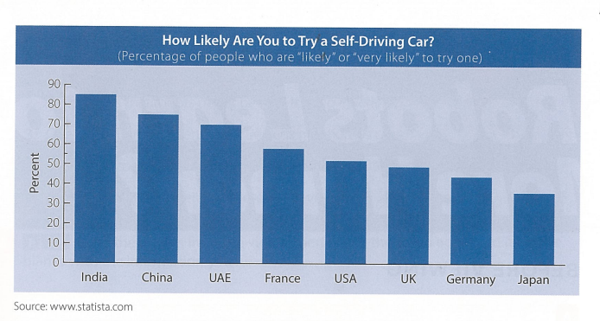
[Survey Title]
[YOUR IMAGE .PNG]
Analysis Questions & Answers
1. What information does this bar graph show? (Include the title and x axis/ y axis).
2. What are the demographics of your survey? (Discuss your two variables).
3. What did the majority of respondents prefer? What did the minority prefer?
4. How would you be represented on the bar graph? Do the results surprise you? Why or why not?
5. What are three possible reasons for this outcome?
6. Based on the evidence, what conclusions can you draw?

Slide 4

Small Group Discussion
What information does your bar graph show?
What are the demographics of your survey?
What did the majority of respondents choose?
What did the minority of respondents choose?
How would you be represented on the bar graph?
Were you surprised by your survey’s outcome?
What are some reasons for your respondent’s selections?
My bar graph shows____________.
I targeted ________.
The majority responded that they’d rather ___________.
The minority responded that they’d rather ___________.
I’d rather _________. I’d be in the (majority/ minority).
The results (do/ do not) surprise me because _____.
Reasons for this survey’s outcome include: ______ and ______.

